Slide 1
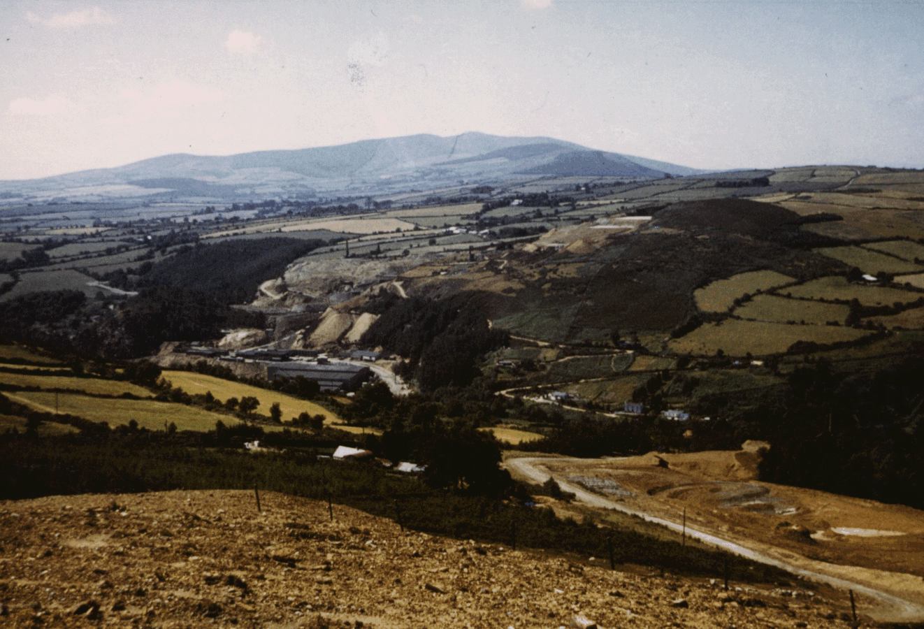
IMC EXPLORATION GROUP PLC
AVOCA Au-Cu-Zn PROJECT
DR BILL SHEPHARD

Slide 2
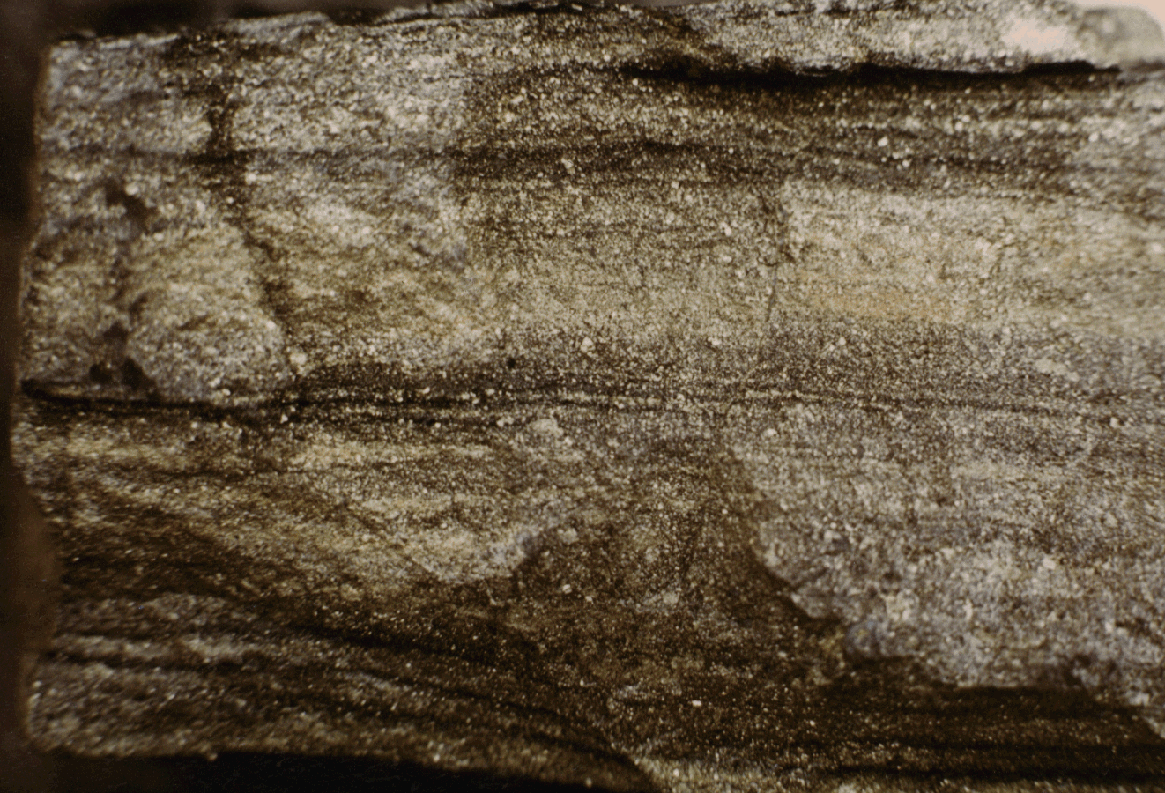
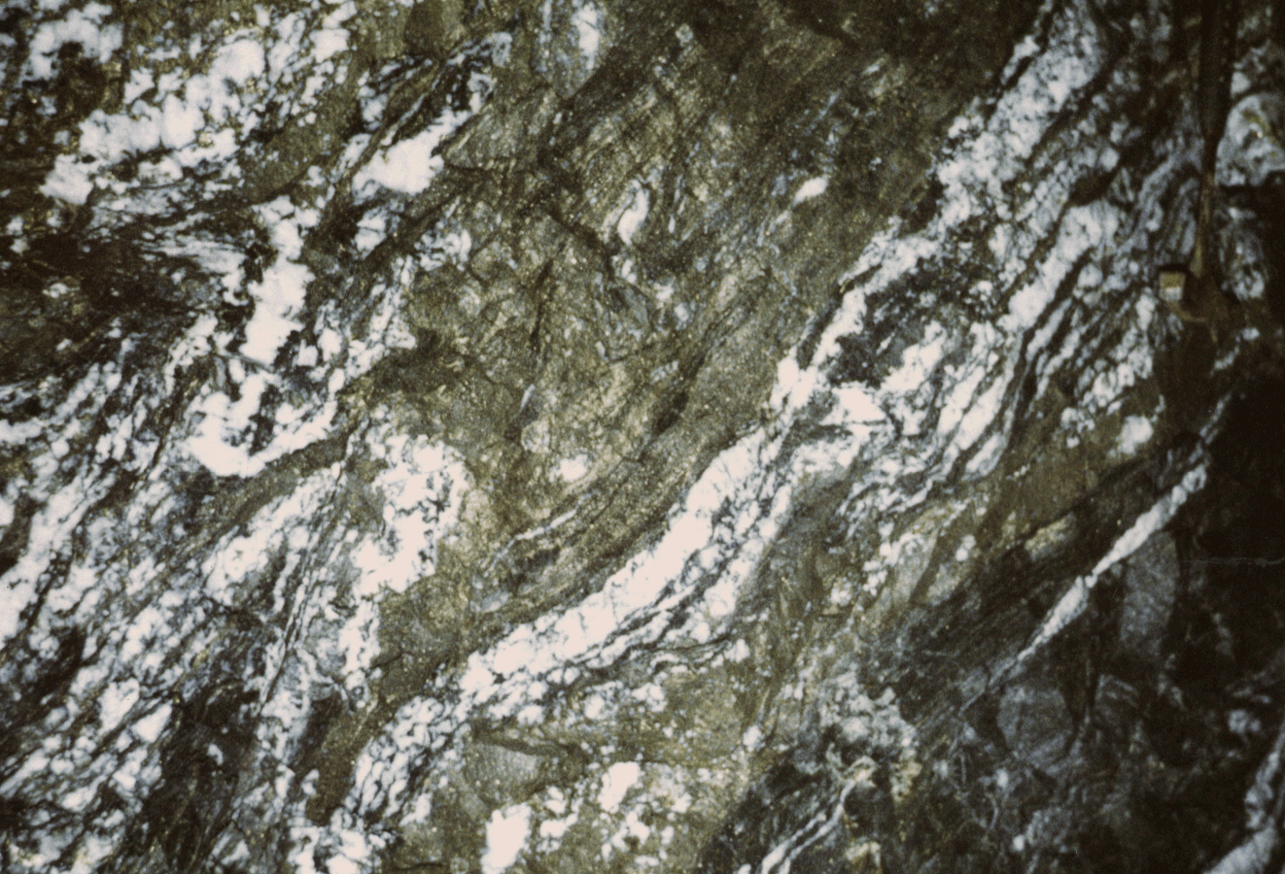
AVOCA Au-Cu-Zn PROJECT Introduction
Massive Ore, West Avoca
West Avoca towards the Goldmines River
IMC has recently acquired exploration rights to two licences adjacent to the former Avoca Cu Mine
Highlights of previous exploration include drill intersections of 7.8m @ 10.92% Zn, 5.22% Pb and 8.3m @ 4.52g/t Au
Stringer Cu Ore, West Avoca

Slide 3
AVOCA Au-Cu-Zn PROJECT Introduction
The Avoca Project Area is mineralized over a strike length of 8km centred on the Avoca Mine
With its history of mining, exploration and research the area is geologically well known
Previous exploration has demonstrated the potential for Au and base metal discovery and the applicability of many modern exploration technologies
In line with its corporate strategy, IMC can fast-track to drilling high priority Au and Zn targets
Kilmacurra
PL3850
PL3849
EAST AVOCA MINE
WEST AVOCA MINE
Avoca
Woodenbridge
2km

Slide 4
AVOCA Au-Cu-Zn PROJECT Geology
Key to geology:
Avoca Mine Sequence (Units 4 & 5)
Schistose Siliceous Sericitic tuffs (Unit 3)
Lithic Tuffs and Potassic Rhyolite (Unit 2)
Mixed Volcanics (Unit 1)
Greenstone/Shale
Diorite
Grey Shales & Phyllite
Purple Shales & Phyllite
Kilmacurra
Ribband
Group
PL3849
Volcanic rocks of the Duncannon Group and older sediments of the Ribband Group underlain the Avoca area
This volcanics are divided into five Units of which the Unit 3 and Unit 4 host the mineralized
WEST AVOCA
EAST AVOCA
2km

Slide 5
AVOCA Au-Cu-Zn PROJECT Introduction
Key to Volcanics:
Avoca Mine Sequence (Units 4 & 5)
Schistose Siliceous Sericitic tuffs (Unit 3)
Lithic Tuffs and Potassic Rhyolite (Unit 2)
Mixed Volcanics (Unit 1)
Rockstown
Kilmacoo
Priority targets and areas of former mining extend from Rockstown in the northeast to Ballymoneen in the southwest
In the last 20 years there has been notable exploration success in Kilmacoo (Au) and Ballymurtagh (Zn-Pb)
There is strong structural control on the distribution of the Units; Unit4 and Unit 5 typically lie within sheared synclinal structures
Connary
EAST AVOCA
Cronebane
WEST AVOCA
Tigroney
Ballygahan
Ballymurtagh
Ballymoneen

Slide 6
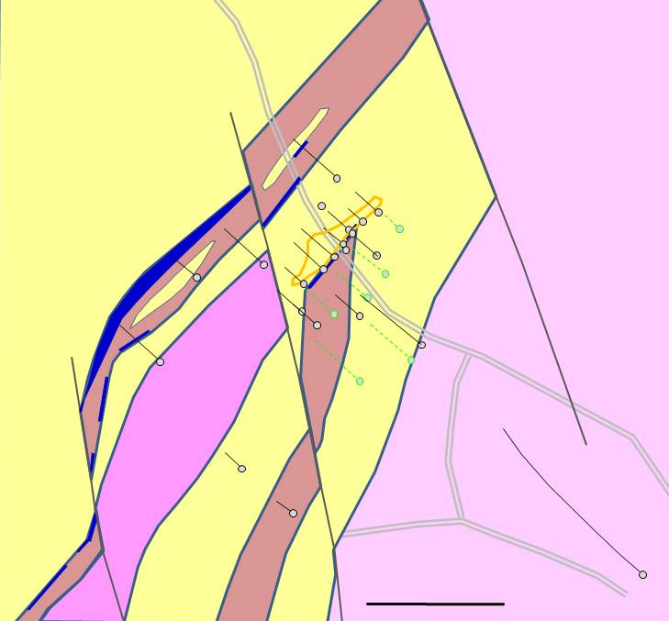
AVOCA Au-Cu-Zn PROJECT Kilmacoo
LEGEND
Unit 4 Volcanic Sediments
Unit 3 Rhyolite
Massive Sulphide
Unit 3 Silicified Tuffs and Sediments
Unit 2 Lithic Tuffs and Rhyolite
Previous Drillhole
Proposed Drillhole
Probable subcrop of zone encompassing drill assay values > 0.2 g/t Au
At Kilmacoo, a Resource of at least 300,000t at 1.5g/t Au was identified by Riofinex associated with ‘banded’ vein quartz
Base metal intersections included 7.8m @ 10.92% Zn, 5.22% Pb and 15.2m @ 7.3% Zn, 3.4% Pb
At the time of drilling the geology was not understood by Riofinex as the following sections will show
200m

Slide 7
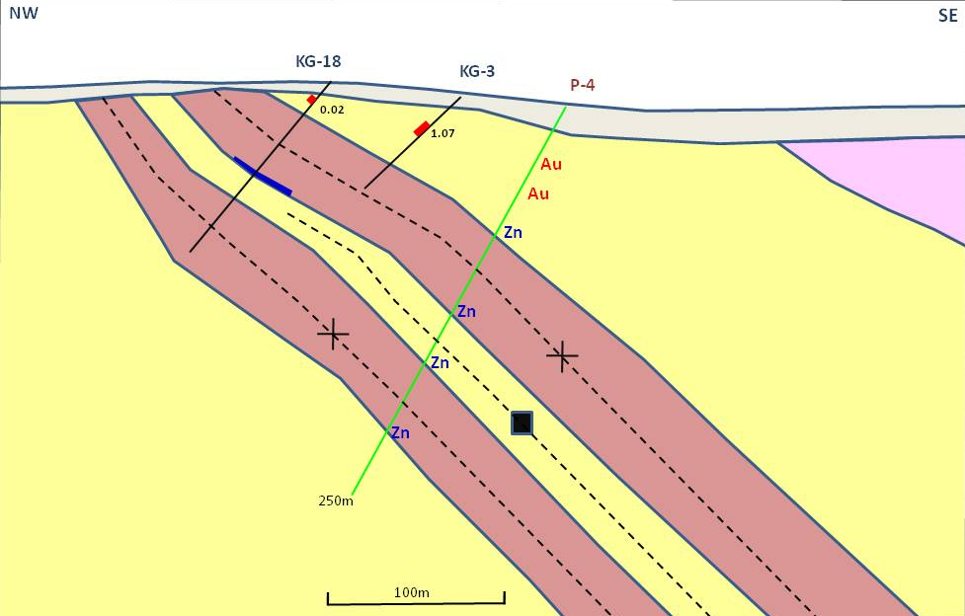
AVOCA Au-Cu-Zn PROJECT Kilmacoo
1.07
LEGEND
Gold Zone with Peak g/t
Zn with Peak Zn%
Target
Au/Zn
LEGEND
Unit 4 Tuffs and Sediments
Massive Sulphide
Unit 3 Silicified Tuffs
Unit 2 Lithic Tuffs and Rhyolite
Previous Drillhole
Proposed Drillhole
Syncline
Anticline
100m
Serial Sections from the northeast show the setting of the mineralization and the extent of drilling
Drilling for Au and Zn is immediately justified down dip of hole KG-3

Slide 8
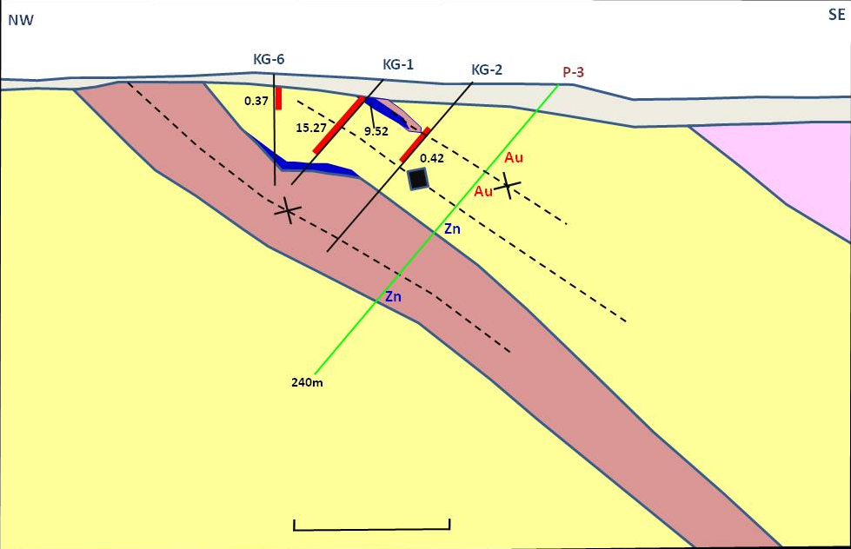
AVOCA Au-Cu-Zn PROJECT Kilmacoo
15.27
9.52
(30m SW of Section)
LEGEND
Gold Zone with Peak g/t
Zn with Peak Zn%
Target
Au/Zn
LEGEND
Unit 4 Tuffs and Sediments
Massive Sulphide
Unit 3 Silicified Tuffs
Unit 2 Lithic Tuffs and Rhyolite
Previous Drillhole
Proposed Drillhole
Syncline
Anticline
100m
This Sections marks the northeastern limit of a hangingwall Unit 4 syncline
Down-dip continuity requires drill testing for Au and Zn

Slide 9
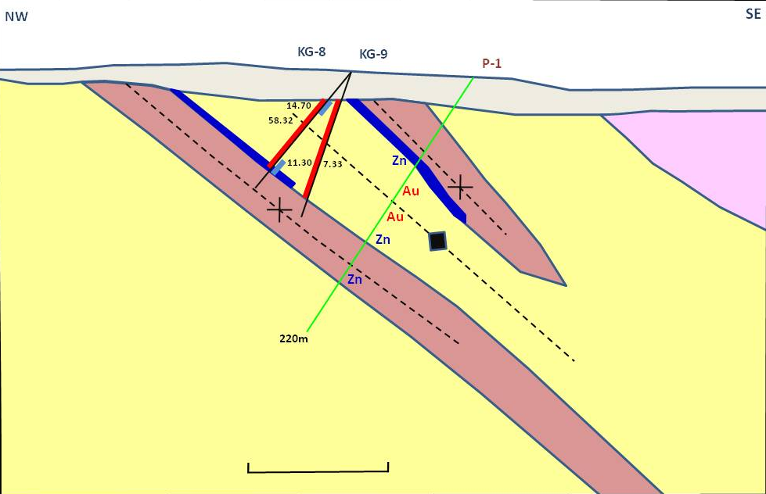
AVOCA Au-Cu-Zn PROJECT Kilmacoo
14.70
BEST BASE METAL INTERSECTION
KG 8: 7.8m @ 10.92% Zn, 5.22% Pb
58.32
7.35
KIL-1
11.30
LEGEND
Gold Zone with Peak g/t
Zn with Peak Zn%
Target
Au/Zn
LEGEND
Unit 4 Tuffs and Sediments
Massive Sulphide
Unit 3 Silicified Tuffs
Unit 2 Lithic Tuffs and Rhyolite
Previous Drillhole
Proposed Drillhole
Syncline
Anticline
100m
It is clear that the best developed Au zone to date lies between the hangingwall and main Unit 4 zones
The down dip extension may have been tested by drillhole AV-1 but this has yet to be reassessed

Slide 10
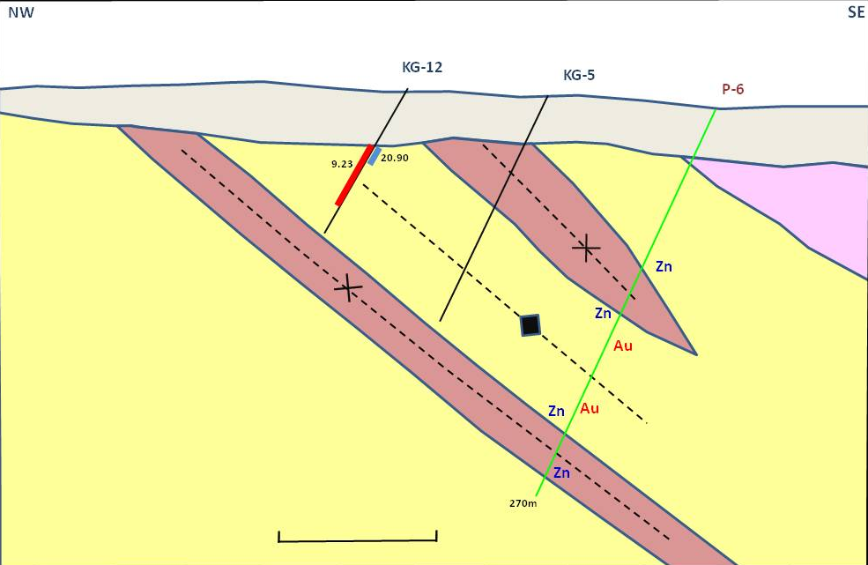
AVOCA Au-Cu-Zn PROJECT Kilmacoo
9.23
20.90
AV-99-01?
Rhyolite
LEGEND
Gold Zone with Peak g/t
Zn with Peak Zn%
Target
Au/Zn
LEGEND
Unit 4 Tuffs and Sediments
Massive Sulphide
Unit 3 Silicified Tuffs
Unit 2 Lithic Tuffs and Rhyolite
Previous Drillhole
Proposed Drillhole
Syncline
Anticline
100m
The Au mineralization lies in the hangingwall of the Cronebane rhyolite that may control Au distribution
Down dip drilling is justified to test a number of Au and Zn targets

Slide 11
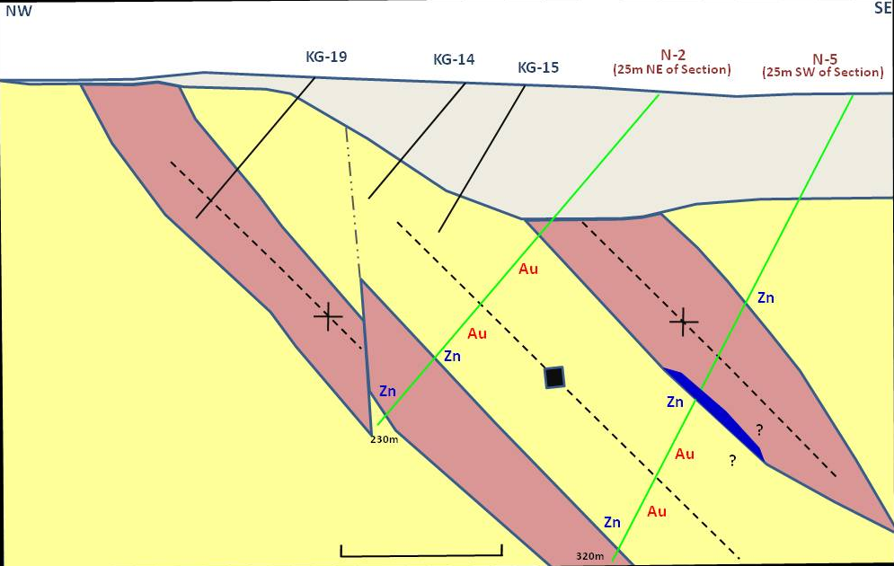
AVOCA Au-Cu-Zn PROJECT Kilmacoo
Rhyolite
LEGEND
Gold Zone with Peak g/t
Zn with Peak Zn%
Target
Au/Zn
LEGEND
Unit 4 Tuffs and Sediments
Massive Sulphide
Unit 3 Silicified Tuffs
Unit 2 Lithic Tuffs and Rhyolite
Previous Drillhole
Proposed Drillhole
Syncline
Anticline
100m
Au values for KG-19 are not to hand, but it does include ‘banded quartz’
Previous drilling was clearly inadequate; two high priority drillholes can test the down-dip potential for Au and Zn

Slide 12
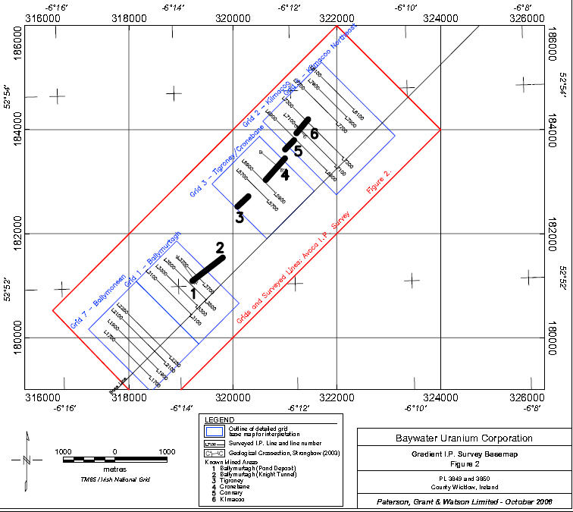
AVOCA Au-Cu-Zn PROJECT Deep-Seeking IP
IMC has access to open file deep-seeking IP data from work by Bayswater in 2006 following cancellation of an airborne EM survey
17, typically 200m spaced Survey lines were completed extending from Kilmacoo to Ballymoneen
Results give indications of the potential for significant sulphide development down to at least 800m
IMC drillhole planning can benefit a great deal from expert opinion of this data using the in-depth geological framework available to the company

Slide 13
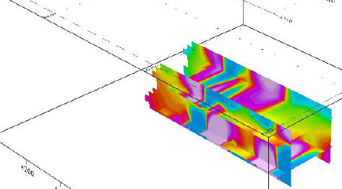
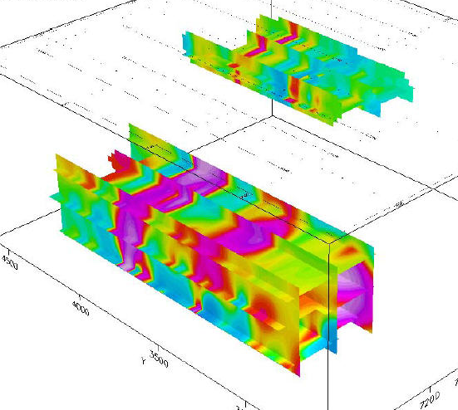
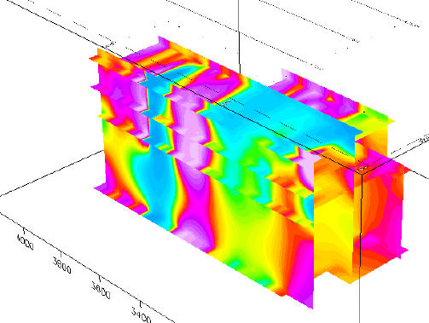
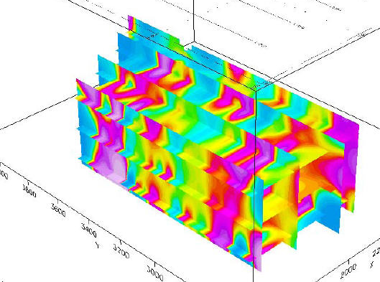
AVOCA Au-Cu-Zn PROJECT Deep-Seeking IP
West Cronebane
Kilmacoo
Ballymurtagh
Here are shown 3D modelling of the deep-seeking IP results for the four principal areas surveyed
The red-purple colours show the distribution of the target zones with highest chargeability
To date, these have only been tested by one drillhole in Kilmacoo and one in West Cronebane
Ballymoneen

Slide 14
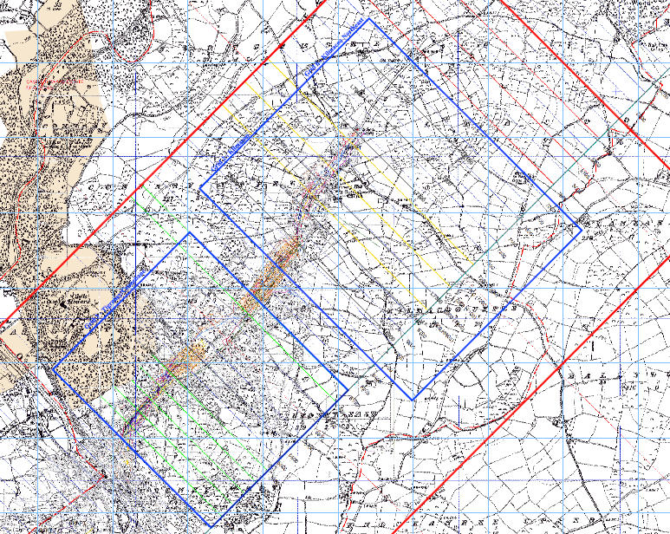
AVOCA Au-Cu-Zn PROJECT East Avoca Deep-Seeking IP
The East Avoca deep-seeking IP survey lines in East Avoca are shown here
Infill surveying should be considered following expert opinion on the existing data
Note the location of the two Bayswater drillholes TG-1 and KIL-1
KIL-01
TG-01

Slide 15
AVOCA Au-Cu-Zn PROJECT Tigroney Deep-Seeking IP
TG-1 was drilled to test the most chargeable target zone in West Cronebane
The relevant IP section is shown
Unfortunately, design of the hole did not take into consideration the universal tendency for holes to lift in the Avoca area
The hole actually passed through a zone of low chargeability about 100m up-dip of the actual target
This drillhole is available for study; the existing log does not immediately shed light on the sequence drilled

Slide 16
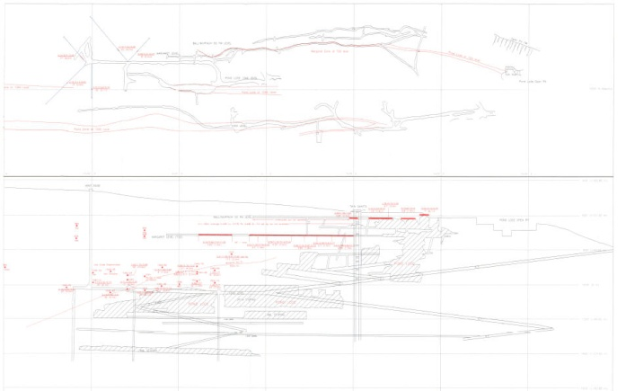
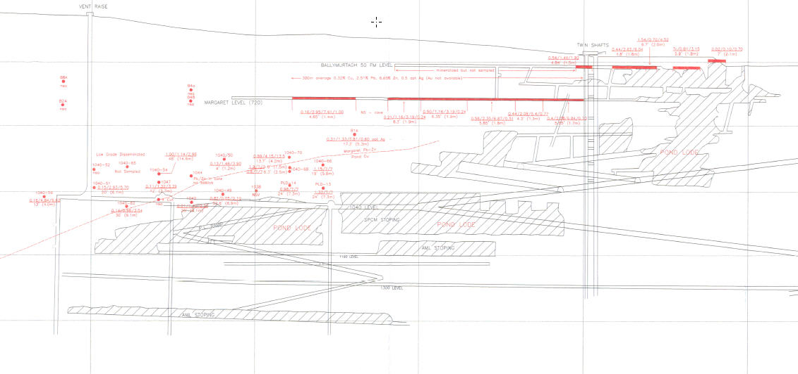
AVOCA Au-Cu-Zn PROJECT West Avoca Long Section
This long section is incomplete, but nonetheless shows the extent and plunge of the Pond Lode massive sulphide in Ballygahan, West Avoca
The 30° southwestward geometry is also that of the South Lode, fold plunges and the stretching direction

Slide 17
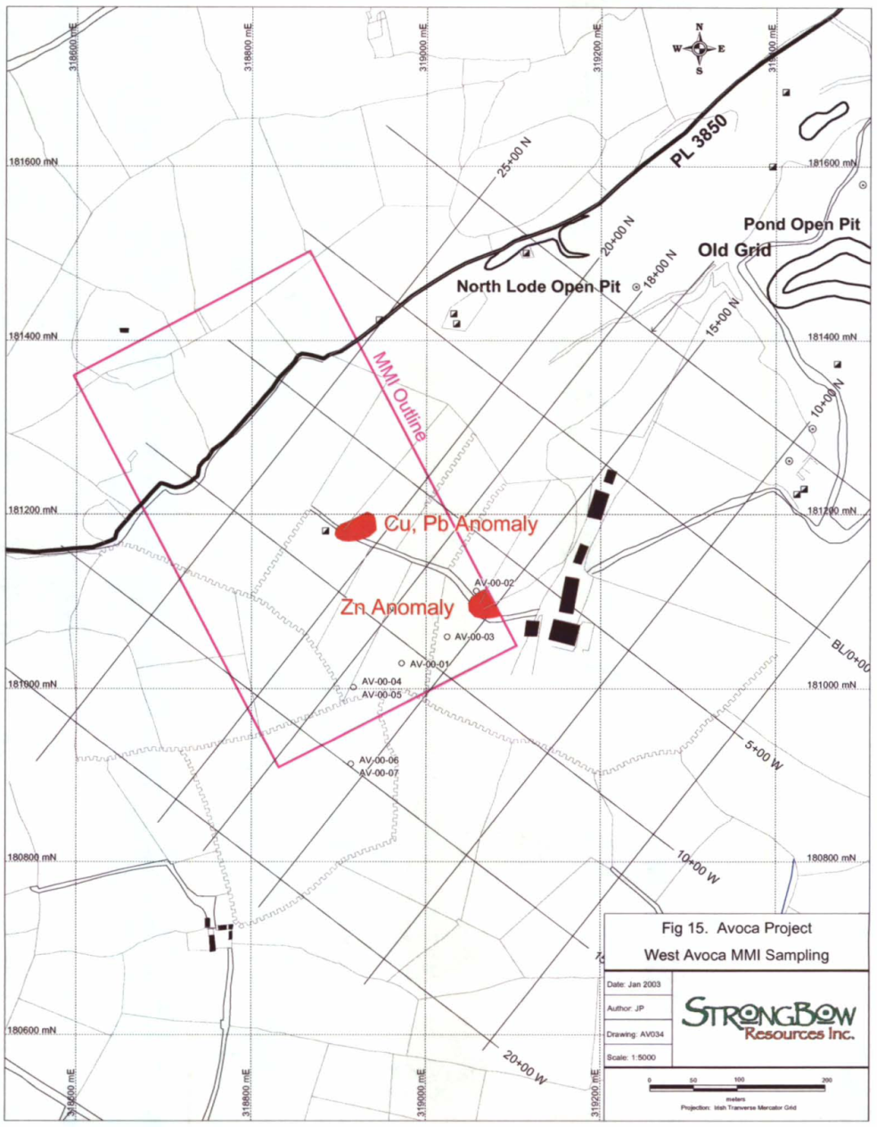
AVOCA Au-Cu-Zn PROJECT Ballymoneen
Exploration at Ballymoneen since the Avoca Mine closed included MMI geochemistry (pink) and drilling in 2000 and deep-seeking IP (red lines) in 2006
Note the location of drillholes in relation of Mine Section 10W
Note that no drill testing of deep-seeking IP has taken place
AV-00-02
AV-00-03
AV-00-04
AV-00-05
AV-00-01
Section 10W
AV-00-06
AV-00-07

Slide 18
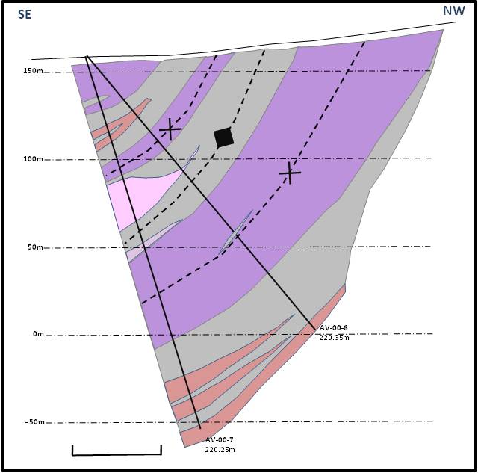
AVOCA Au-Cu-Zn PROJECT Ballymoneen
LEGEND
Unit 5 Mafic Unit
Unit 4 Fine Sediments
Massive Sulphide Zone
Unit 4 Rhyolite
Unit 4 Volcanic Sediments
Unit 3 Volcanics
Previous Drillhole
Syncline Axis
Anticline Axis
0.5m @ 0.27%Cu, 7.02%Zn, 3.14%Pb
Geological Units by Sheppard; no core available
These 3 serial sections through Ballymurtagh reveal the results from the 7 drillholes in 2000
They show the geological interpretation and depth to which the targets were tested
This westernmost section shows AV-00-07 the deepest hole drilled
0.8m @ 0.12%Cu, 2.61%Zn, 1.14%Pb
AV-00-6
220.35m
2.05m @ 0.37%Cu, 4.1%Zn, 0.87%Pb
0.7m @ 0.06%Cu, 5.32%Zn, 1.44%Pb
50m
AV-00-7
220.25m

Slide 19
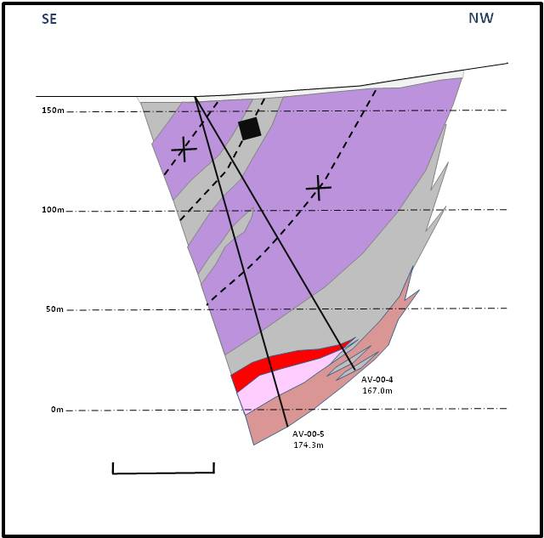
AVOCA Au-Cu-Zn PROJECT Ballymoneen
LEGEND
Unit 5 Mafic Unit
Unit 4 Fine Sediments
Massive Sulphide Zone
Unit 4 Rhyolite
Unit 4 Volcanic Sediments
Unit 3 Volcanics
Previous Drillhole
Syncline Axis
Anticline Axis
0.5m @3.2%Zn, 0.89% Pb
Results show high grade Zn-Pb mineralization within a flat-lying massive sulphide zone
Logs indicate that the footwall Unit 3 lithologies were not intersected
9.0m @10.25%Zn, 4.78% Pb
AV-00-4
167.0m
AV-00-5
174.3m
50m

Slide 20
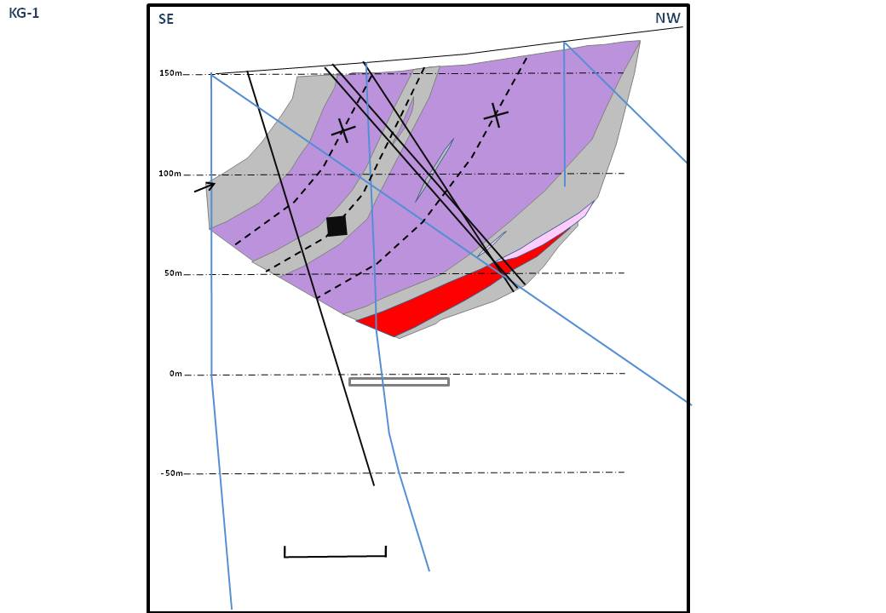
AVOCA Au-Cu-Zn PROJECT Ballymoneen
LEGEND
1.95m @ 6.42% Zn, 3.56% Pb, 91 ppm Ag
Unit 5 Mafic Unit
Unit 4 Fine Sediments
Massive Sulphide Zone
Unit 4 Rhyolite
Unit 4 Volcanic Sediments
Unit 3 Volcanics
Previous Drillhole
Syncline Axis
Anticline Axis
3.53m @ 11.89% Zn, 5.39% Pb, 119 ppm Ag
AV-00-2
20.0m NE
This composite section is based on the geological interpretation of AV-00-01 close in Mine Section 10W
It shows the relative position of the three easternmost drillholes AV-00-01/02/03
It also shows a projection of AV-00-07, the deepest hole and preceding mine drillholes
AV-00-1
75.0m SW
AV-00-3
20.0m SW
12.8m @ 7.94% Zn, 3.24% Pb, 28 ppm Ag
50m
1.3% Cu
2.06% Cu
2.19% Cu, 25.4% Zn, 4.56% Pb, ? Ag
0.94% Cu

Slide 21
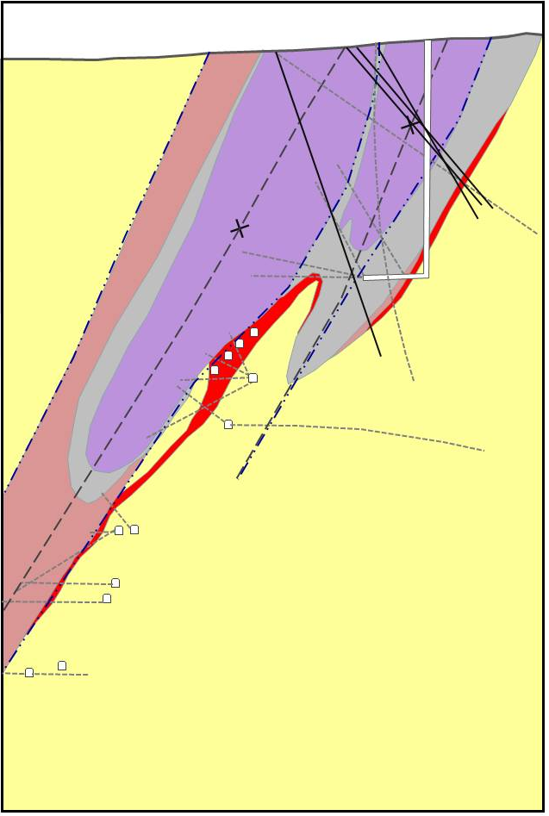
AVOCA Au-Cu-Zn PROJECT Actual Geology Ballymoneen
Mine Opening
Carbonate Zone
(Keating Zone)
AV-00-1 (40mSW)
AV-00-2 (75mNE)
AV-00-3 (20mNE)
Pond Lode
Of course, mining and mine drilling, some of which is shown here, established the detailed geology of Section 10W pre-2000
Here is shown the relationship of the 2000 drilling to the actual mine geology based on compilation by Platt and Sheppard
Clearly the Carbonate Zone was misinterpreted and drilling at Ballymoneen has only scratched the surface
AV-00-7 (150mSW)
Deepest ‘AV’ Hole
Unit 5 Mafic Unit
Unit 4 Fine Sediments
Massive Sulphide Zone
Unit 4 Rhyolite
Unit 4 Volcanic Sediments
Unit 3 Volcanics
Exploration Drillhole
Mine Drillhole
Syncline Axis
Mine Opening

Slide 22
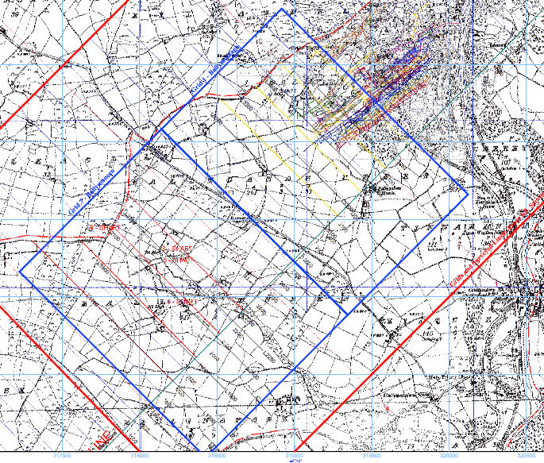
AVOCA Au-Cu-Zn PROJECT West Avoca Deep-Seeking IP
The deep-seeking IP indicates that sulphide is developed to at least 800m
At Ballymoneen, west of the 2000 drilling there is, therefore, a strike extent of 400m to be tested to 800m
The area of 2000 drilling requires testing from a depth of 200m to 800m over a strike length of about 200m
There is still potential for major discovery
‘AV-00’ Series Drill Collars

